Slide 1
University of Basra College of medicine The kidney and the urinary tract system Dr. Zainab A. Ameen Iraqi board of histopathology and forensic medicine

Slide 2
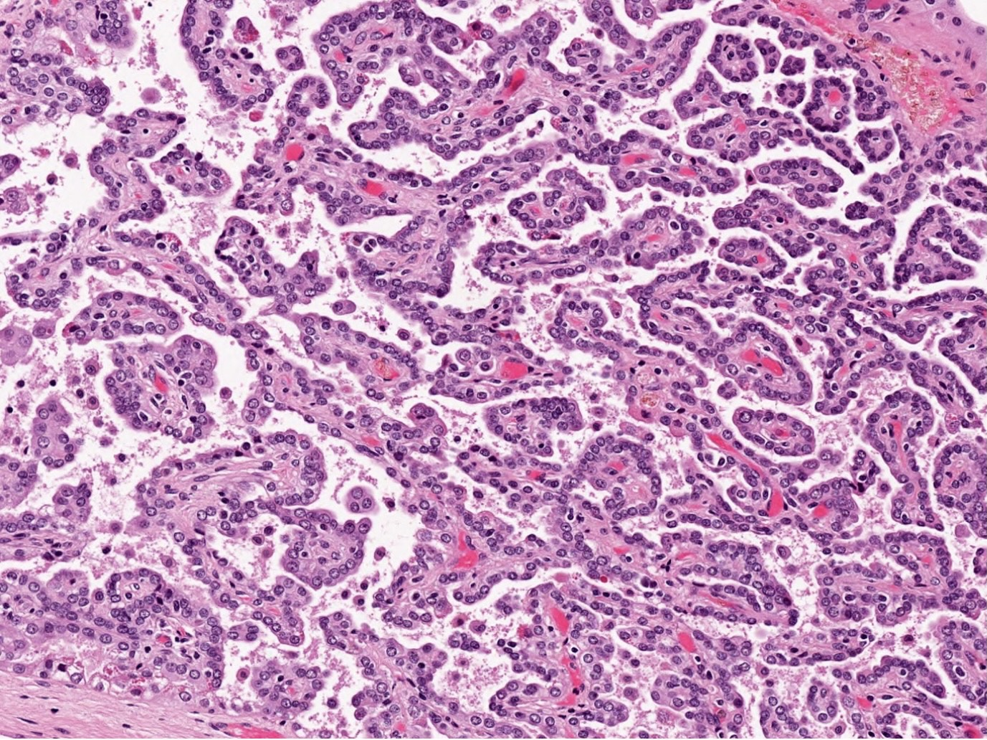
Neoplasms of the kidney Benign tumors 1. Renal papillary adenoma . Small cortical mass, 0.5 cm in size , arise from tubular epithelial cells . Yellow-gray, well- circumscribed nodule . Papillary architecture with low grade nuclei

Slide 3
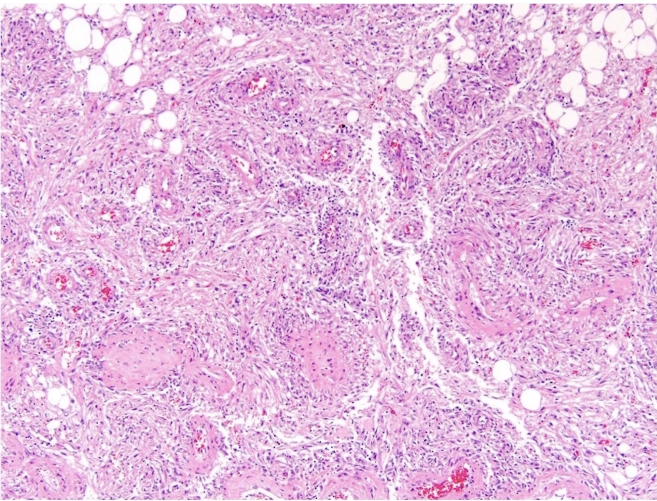
2.Angiomyolipoma . Triphasic tumor: vessels, smooth muscle, and fat . Present in 25% to 50% of patients with tuberous sclerosis . Susceptibility to spontaneous hemorrhage

Slide 4
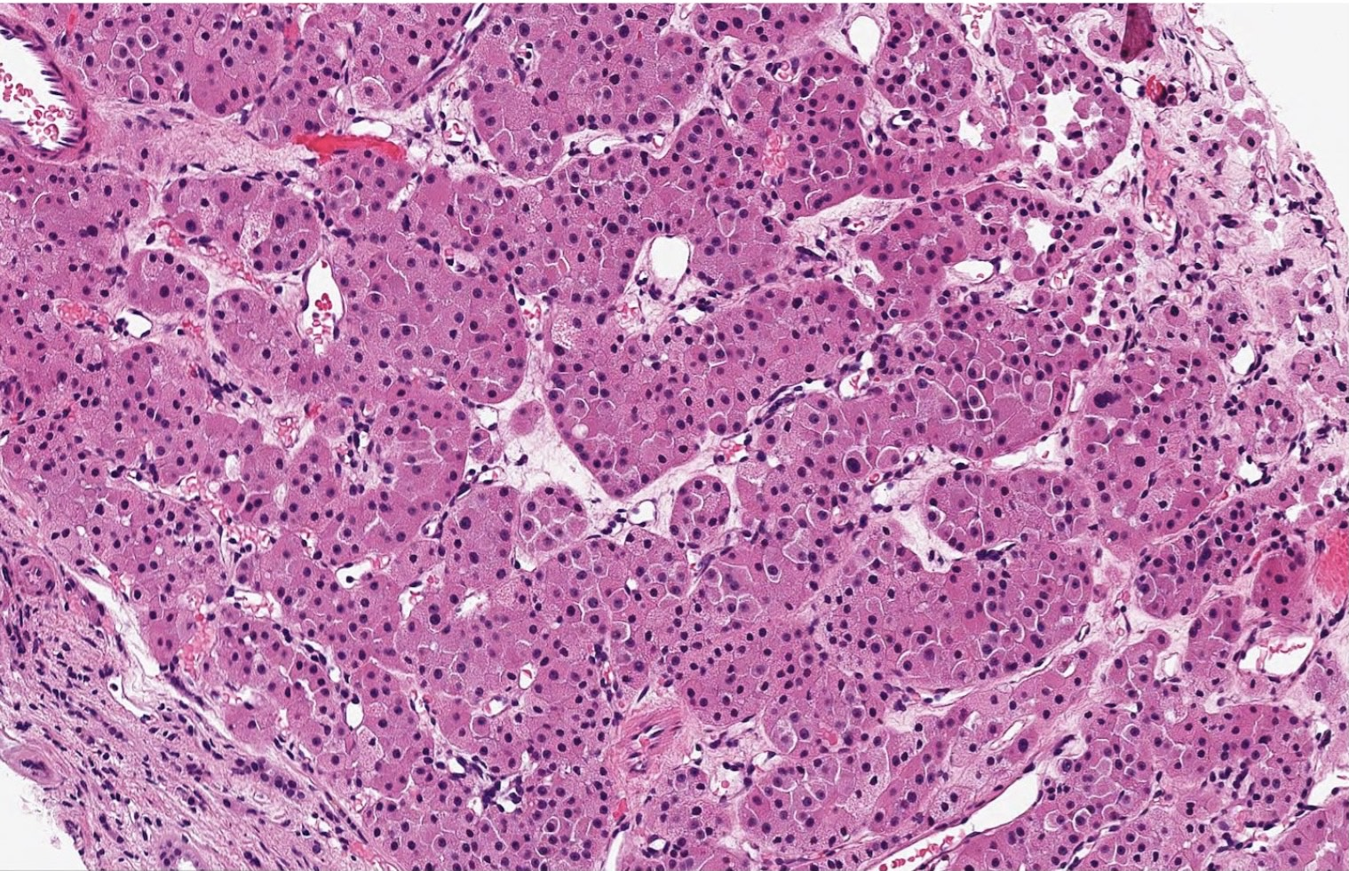
3.Oncocytoma . 10% of renal tumors . Arise from the intercalated cells of collecting ducts . well circumscribed tan or mahogany brown . Large round eosinophilic cells have numerous mitochondria, solid nests

Slide 5
Malignant Neoplasms Renal Cell Carcinoma(RCC) - 85% of renal cancers in adults - 2-3 % of all cancers in adult - Sixth and seventh decades - 2:1 male preponderance - Predominantly cortical - Most cases are sporadic - Develop in 50% of individuals with vonHippel- Lindau disease ( VHL ) -

Slide 6
Risk factors 1. Cigarette smokers 2. Obesity 3. Hypertension 4. Unopposed estrogen 5. Asbestos, petroleum products ,heavy metals, 6. ESRD, CKD, acquired cystic disease anTS

Slide 7
Clinical features 1. Usually asymptomatic 2. Dull flank pain, palpable mass, and hematuria 3. Constitutional symptoms 4. Paraneoplastic syndromes 5. Metastasis (Lungs , Bone, Lymph nodes, Liver)

Slide 8
Spread and metastasis - Direct extension into into the ureter - May extend to inferior vena cava and the right side of the heart - Sites of metastasis lungs (50%) , bones (33%) Prognosis 5-year survival rate 70% , and as high as 95% in the absence of distant metastases

Slide 9
The 3 major types of RCC: 1. Clear cell carcinoma 2. Papillary carcinoma 3. Chromophobe carcinoma Clear cell carcinoma - The most common subtype (65% of all renal cell carcinomas ) - 95% sporadic - 98% of these tumors, whether familial, sporadic, or associated with VHL disease , have VHL gene mutation at 3p

Slide 10
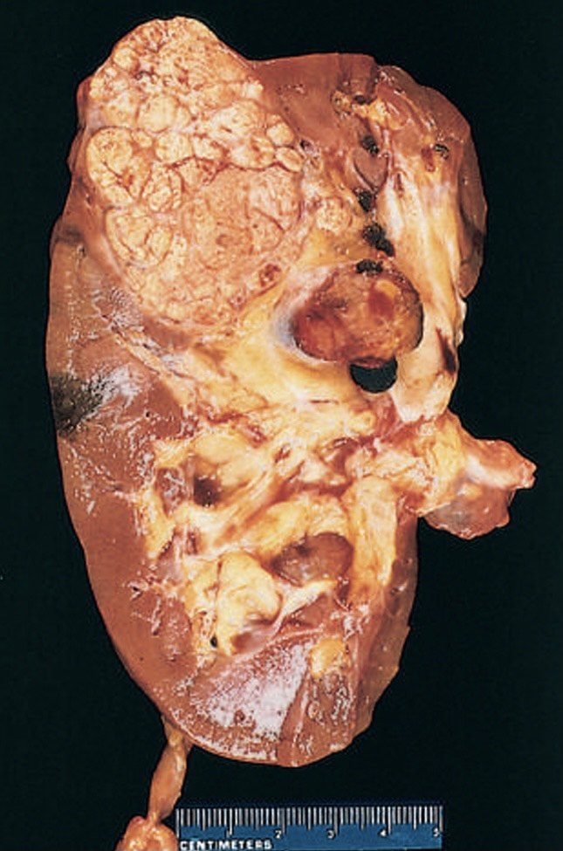
Morphology Gross - Well defined solitary large (3-15cm) unilateral mass - yellow-orange cut section , prominent hemorrhage and cystic changes

Slide 11
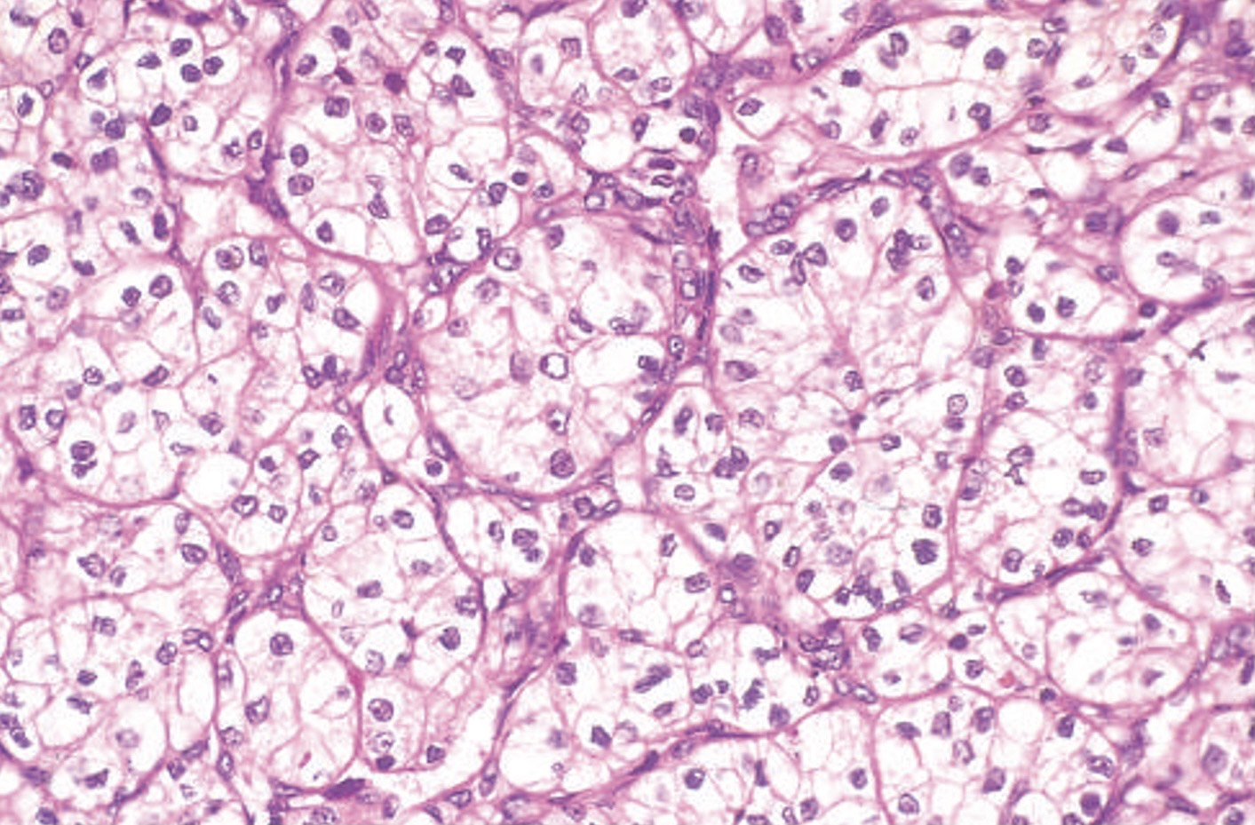
Microscopy Compact nests and sheets of cells with clear cytoplasm and distinct membranes , small round nuclei , scant and highly vascularized stroma

Slide 12
Papillary carcinoma - 10% to 15% of renal cancers - Papillary growth pattern - Familial and sporadic forms - Not associated with 3p deletions - Trisomies 7 and 17 and loss of Y , most cases have MET gene mutation on chromosome 7

Slide 13
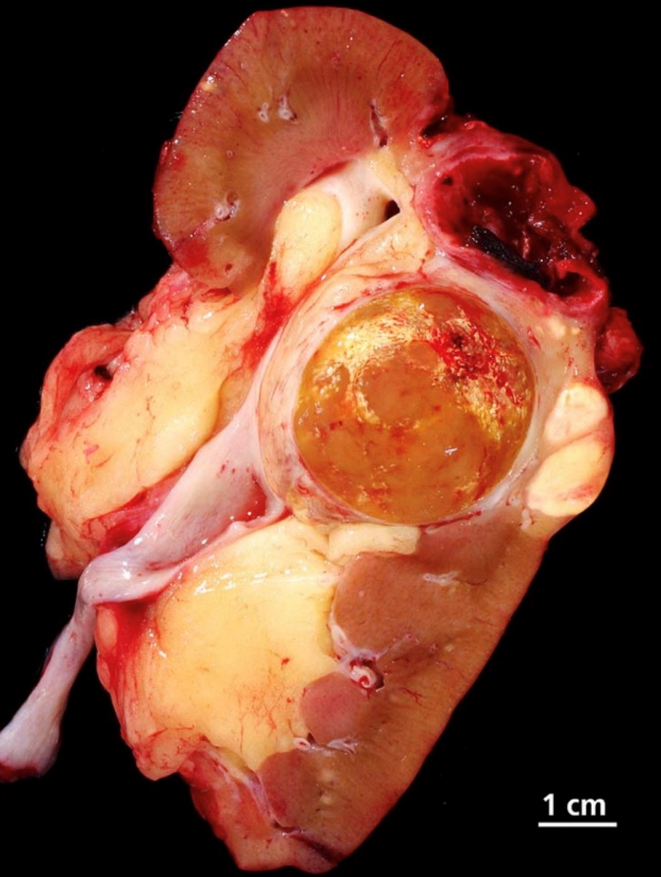
Morphology Gross - Tend to be multifocal and bilateral - May show necrosis ,hemorrhage, cystic degenerations - less vibrantly yellow- orange

Slide 14
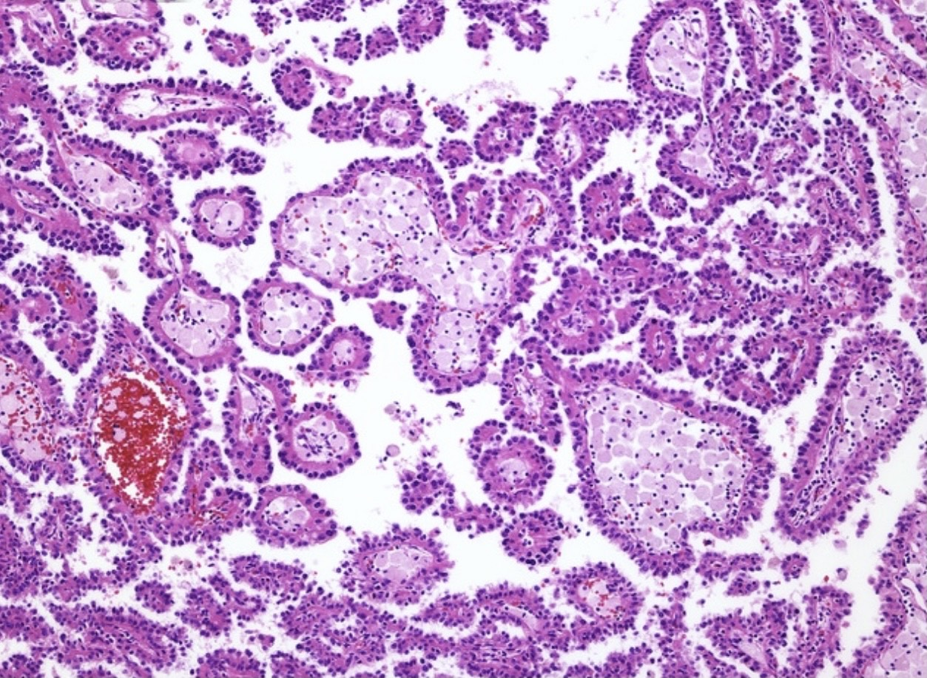
Microscopy . Cuboidal or low columnar cells arranged in papilla with fibrovascular core . Foamy macrophages are common in the papillary cores . Psammoma bodies may be present . The stroma is usually scanty but highly vascularized

Slide 15
Chromophobe carcinoma - 5% of renal cell cancers - Multiple chromosome losses → extreme hypodiploidy - Arise from intercalated cells of collecting ducts - Excellent prognosis compared with that of the clear cell and papillary cancers

Slide 16
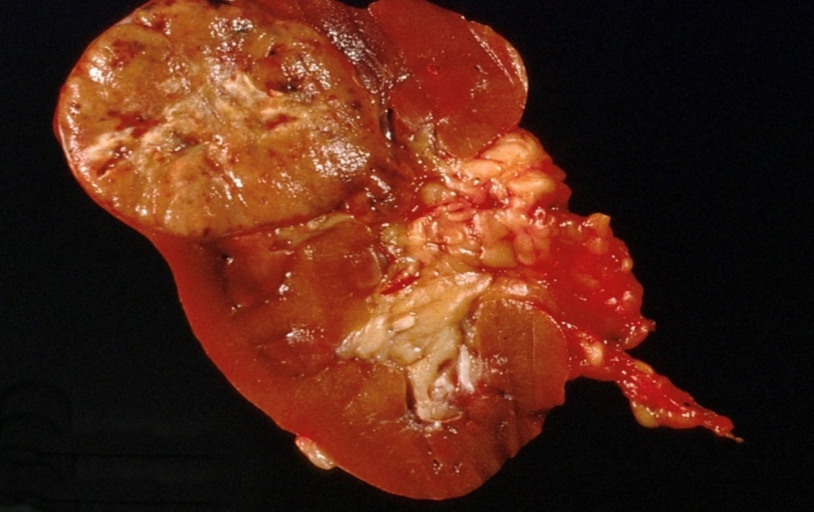
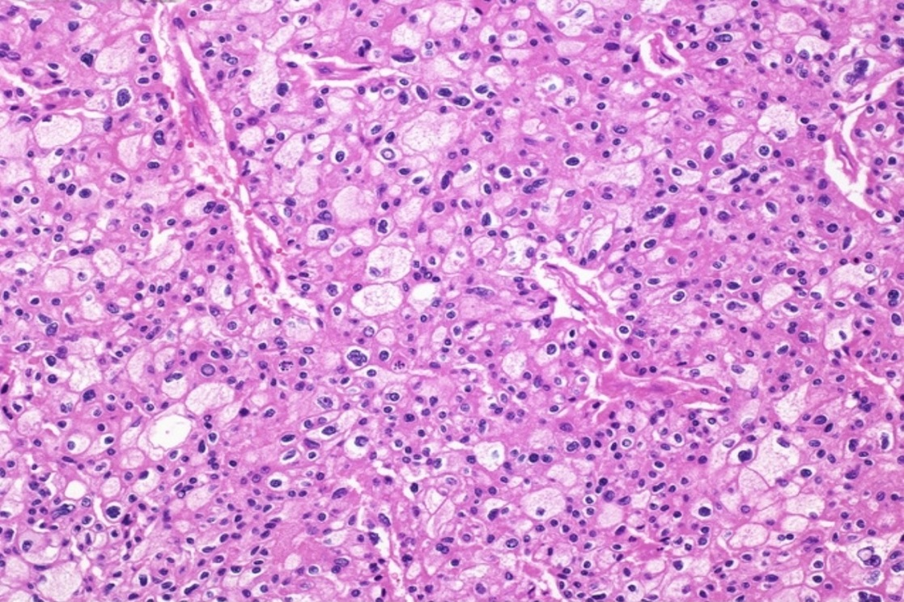
Morphology Gross - Tan brown Well circumscribed solitary mass Microscopy . Pale eosinophilic cells, perinuclear halo, solid sheets Very prominent distinct cell membrane

Slide 17
Wilms tumor - Malignant embryonal tumor - The most common primary tumor of the kidney in children - 2-5 years - Palpable abdominal mass - Prognosis is generally very good

Slide 18
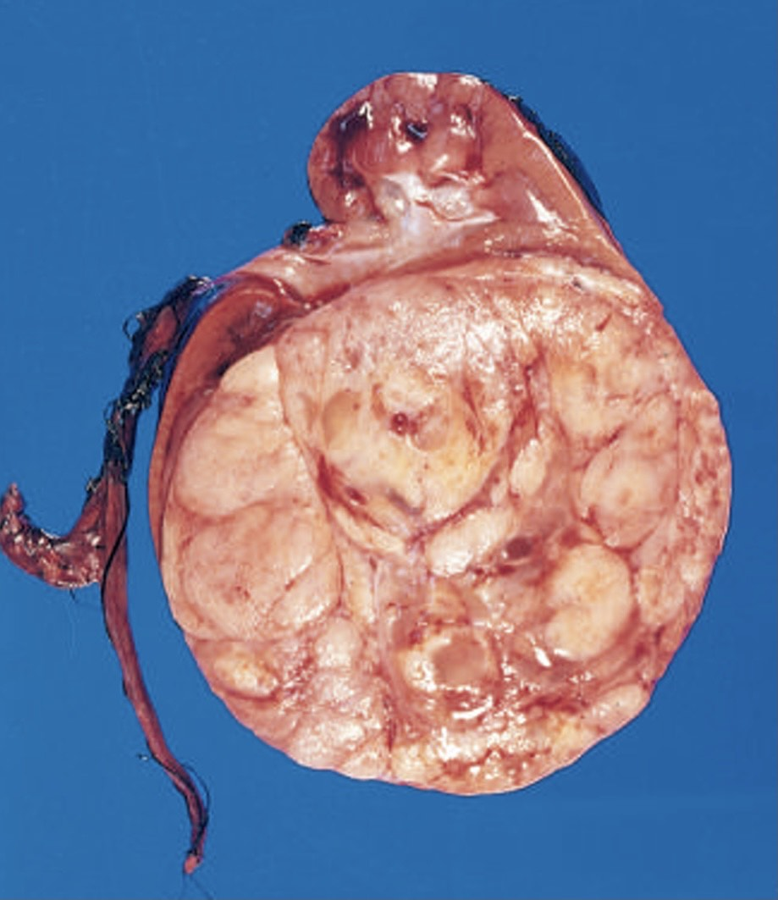
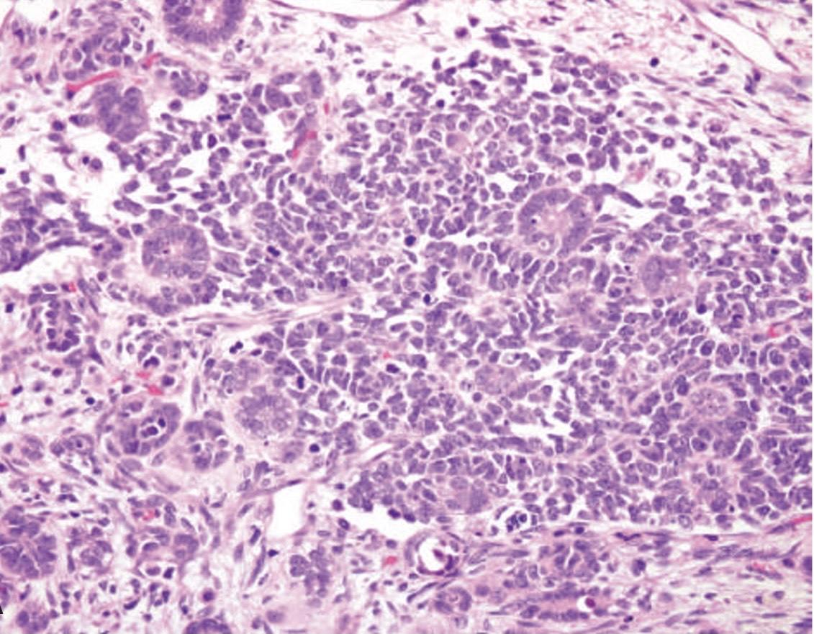
Gross - Unilateral large well circumscribed - Soft tan gray Microscopy Triphasic combination : 1. Blastema cells 2. Epithelial cells 3. Stromal Spindle cells.

Slide 19
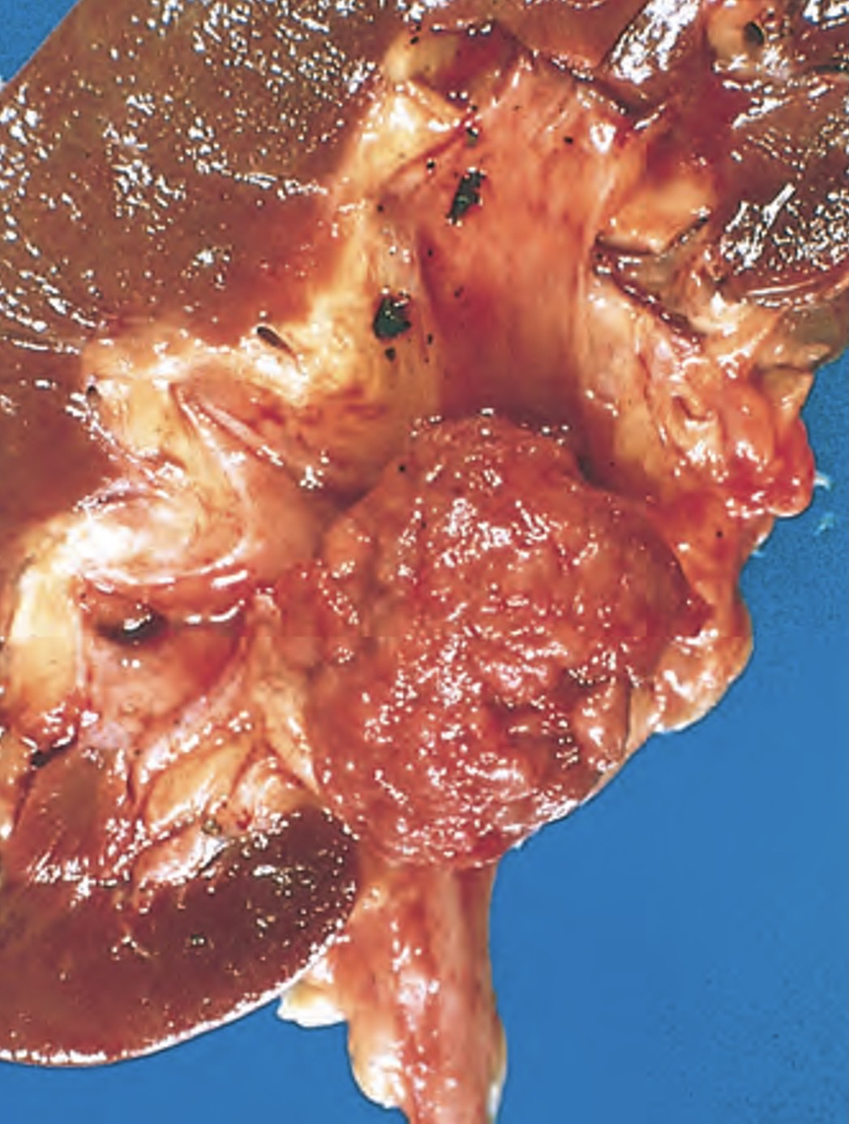
Urothelial Carcinoma of the Renal Pelvis - 5% to 10% of primary renal tumors , arise from the renal pelvis urothelium - CF: obstruction ,hematuria - Small when discovered - Similar to urothelial tumors of bladder, most are papillary

Slide 20
Ureters Disorders of the ureter are uncommon and include 1.Congenital Anomalies -uretropelvic junction obstruction (UPJ) -double and bifid ureters -diverticuli 2. inflammation 3.Tumors

Slide 21
Urinary Bladder Congenital Anomalies 1. Vesicoureteral reflux 2. Diverticula 3. Exstrophy of the bladder 4. Urachal anomalies

Slide 22
Inflammation cystitis takes many forms 1. Bacterial : - common - more in women - most agents are coliform bacteria 2. Hemorrhagic: - adenovirus - cytotoxic drugs

Slide 23
3. Interstitial cystitis( chronic pelvic pain syndrome) - women - suprapubic pain increase with bladder filling - frequency, urgency, hematuria , dysuria - cystoscopy: petechial hemorrhage - 50% spontaneous remission - late: transmural fibrosis→ contracted bladder

Slide 24
4. Malakoplakia - uncommon - defect in macrophage phagocytic function - accumulation of undigested bacterial products within macrophages (abundant granular material) - yellow mucosal plaques

Slide 25
Metaplastic Lesions 1. Cystitis glandularis and cystitis cystica - Common - Nests of urothelium (Brunn nests) grow downward into the lamina propria - Nest are lined by a cuboidal or columnar appearance (cystitis glandularis), or lined by flattened urothelium (cystitis cystica)

Slide 26
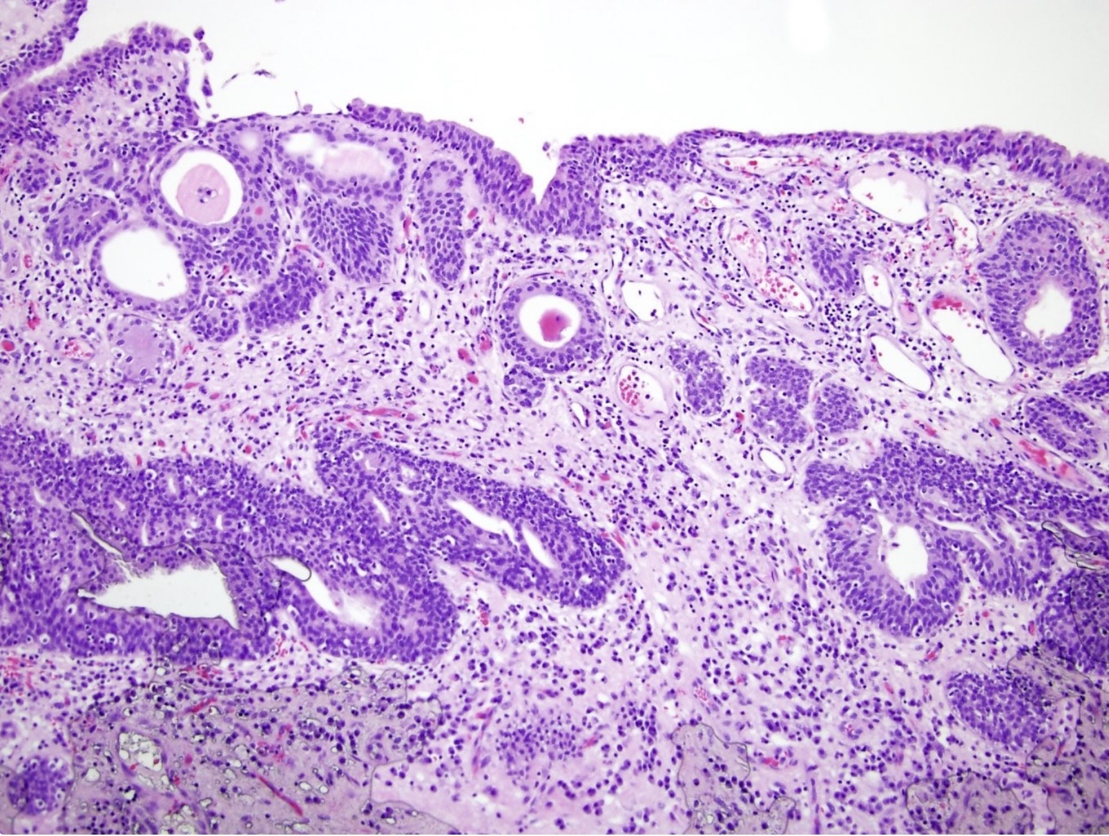
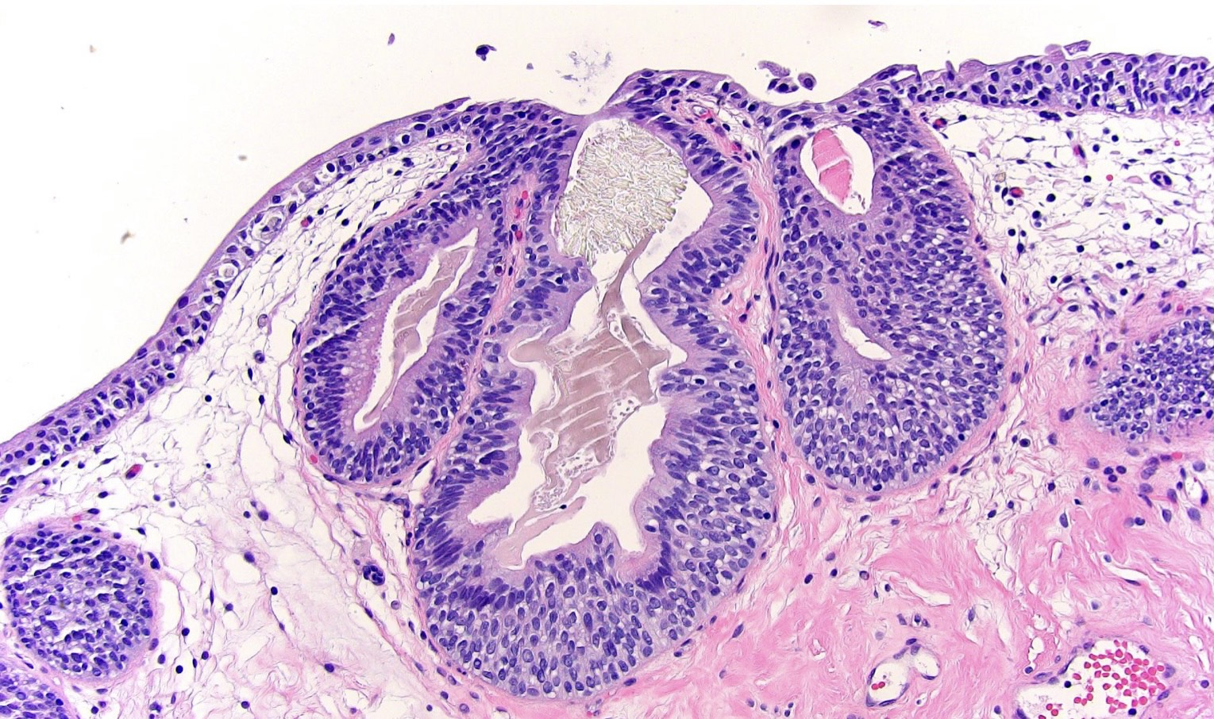
Cystitis glandularis Cystitis cystica

Slide 27
2. Squamous metaplasia - Results from chronic inflammation, stones & schistosomiasis - Predispose to squamous cell carcinoma of the bladder Neoplasms - 5 % of cancers - 95% of bladder tumors are of epithelial origin - Most epithelial tumors are urothelial (urothelial or transitional tumors)

Slide 28
Urothelial carcinoma - 90% of all bladder carcinomas - higher in men - more in developed nations - Trigone is the most common site - 50 - 80 years Predisposing factors 1. Cigarette smoking 2. Chemical substances: aryl amines 3. Cyclophosphamide 4. Bladder Radiation

Slide 29
-Two distinct precursor lesions ( found in 50% of cases): 1. Non invasive papillary neoplasm 2. CIS - the most important prognostic factors for the noninvasive carcinoma is the grade Classification of papillary urothelial tumors 1. Papilloma 2. Papillary urothelial neoplasm of uncertain malignant potential (PUNLMP) 3. Low grade papillary urothelial carcinoma (LGUC) 4. High grade papillary urothelial carcinoma (HGUC)

Slide 30
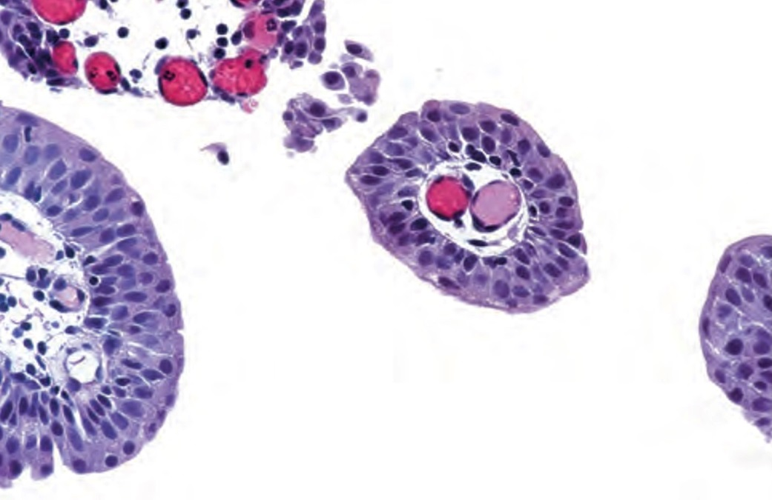
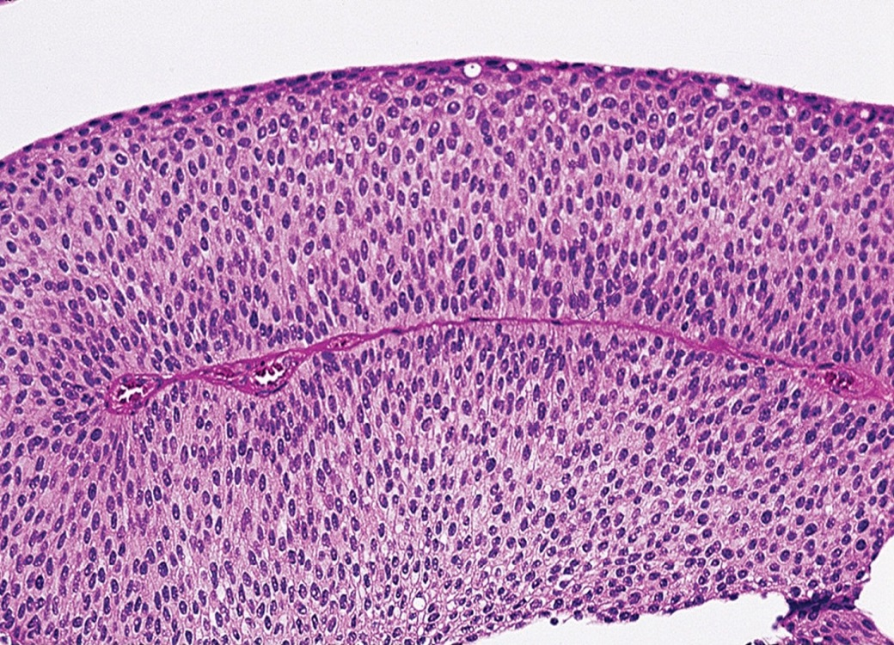
Papillomas -younger patients. - Single small (0.5- 2 cm) - finger-like papillae - identical to normal urothelium PUNLMP histologically similar with papilloma,but having thicker urothelium

Slide 31
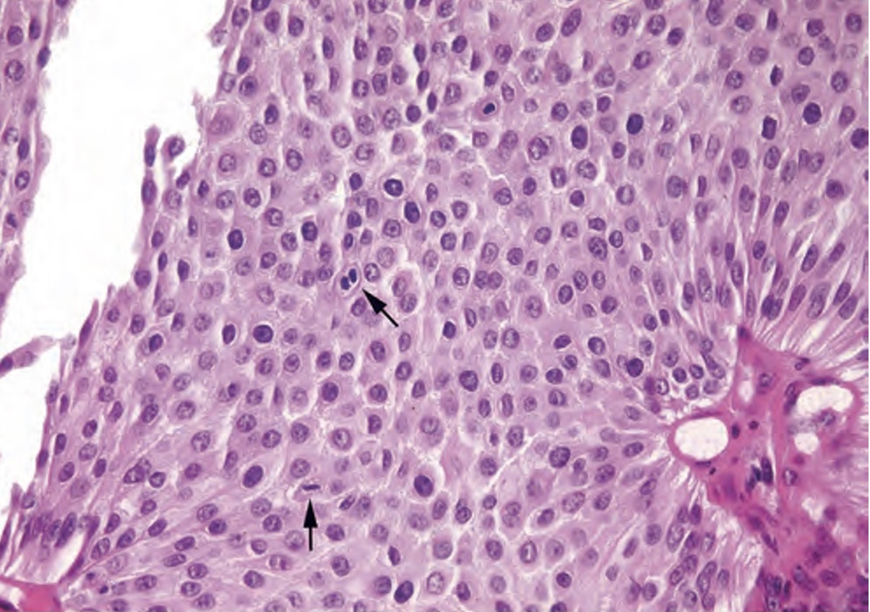
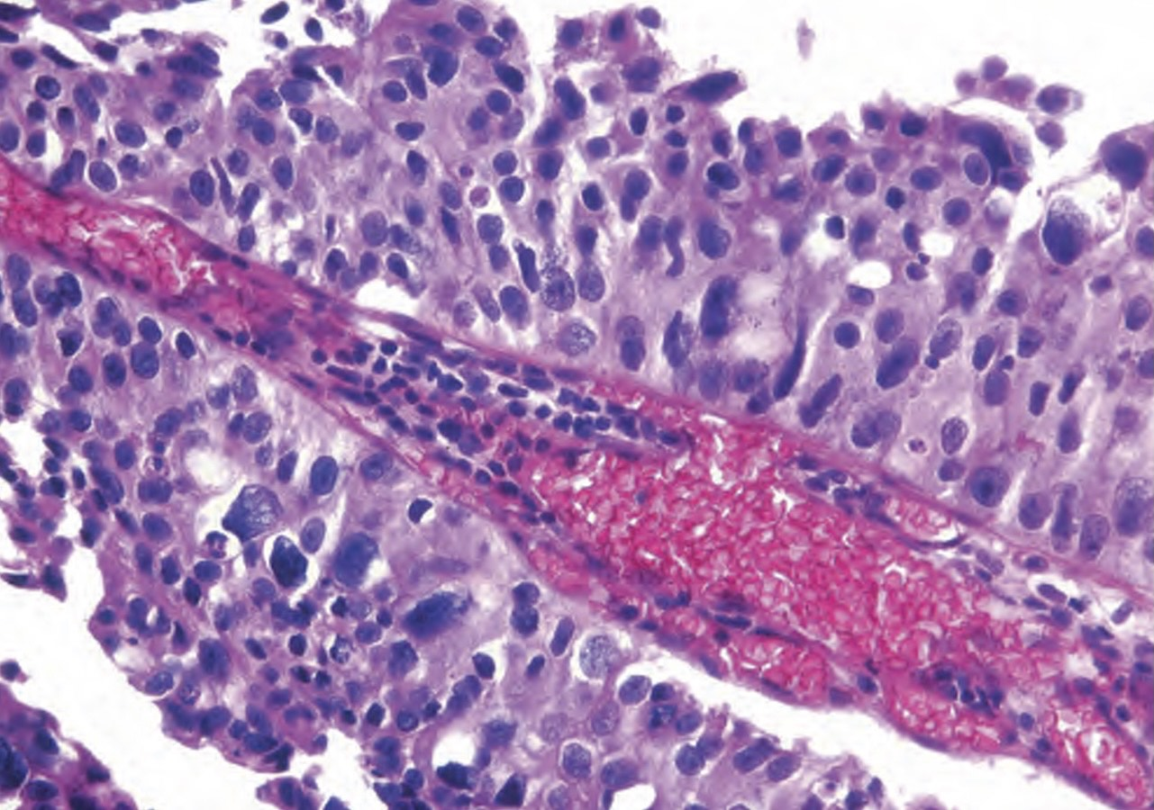
LGUC HGUC - orderly apearance - dyscohesive cells - mild nuclear atypia - loss of polarity - high grade nuclei

Slide 32
Invasive urothelial carcinoma - associated with papillary urothelial cancer or adjacent CIS - invade the lamina propria or extend deeper into the underlying muscle - almost all invasive carcinomas are of high grade clinical features painless hematuria, frequency, urgency, dysuria

Slide 33
Prognosis depend on : - Tumor Grade - Tumor Stage Squamous cell carcinoma - 3-7% of bladder cancer - associated with chronic bladder irritation and infection( schistosomiasis) Adenocarcinoma -rare -histologically identical to adenocarcinoma of the GIT

Slide 34
Urethra 1. Inflammation -gonococcal - non gonococcal 2. tumors > Urethral caruncale: Painful red inflammatory nodule 1-1.5 cm in the external urethral meatus in female > benign epithelial tumors > primary carcinoma(rare) -proximal urethra: urothelial carcinoma -distal urethra: squamous cell carcinoma

